Slide 1
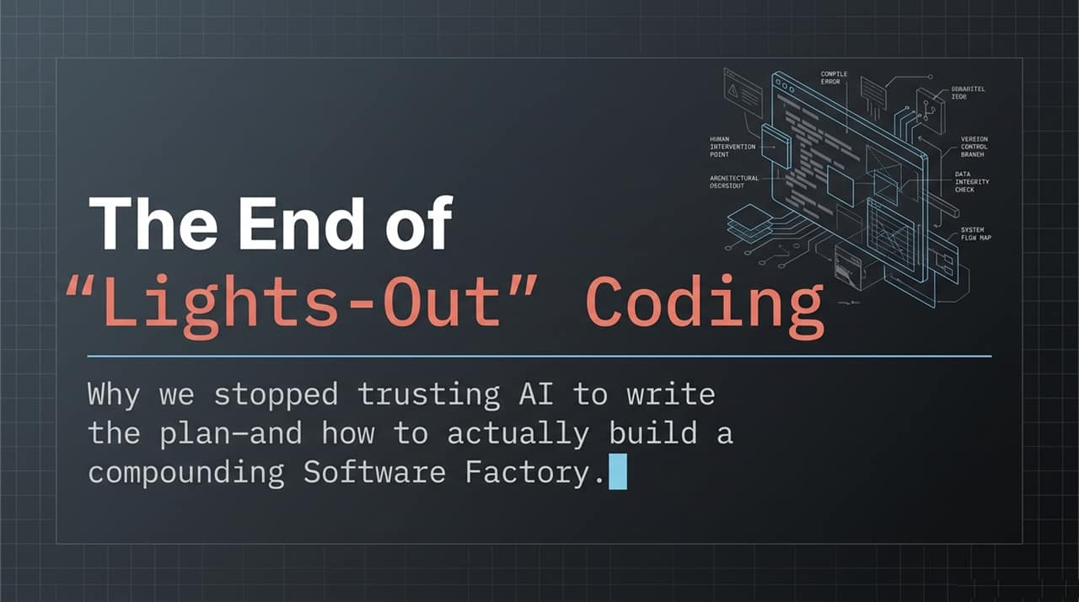
Notes:
Welcome & Introduction: Welcome everyone. Today, we're talking about a major shift in how we build software with AI—specifically, why we have moved past the fantasy of 'lights-out' autonomous coding and how to actually build a sustainable, compounding Software Factory.
The Promise vs. Reality: Over the past year and a half, the engineering community went through an extreme hype cycle. We all wanted to believe that AI agents could take high-level prompts, disappear into the dark, and output perfect pull requests while we slept.
The Pivotal Shift: In this presentation, based on real-world engineering hard lessons from building agentic systems—specifically drawing from Dex Horthy’s experience at Human Layer—we're going to examine why complete delegation fails, why unmonitored AI ruins codebases, and how to introduce human architectural oversight back into the loop.
The 'Dumb Zone': Why More Context Makes Your Agent Dumber
https://www.youtube.com/watch?v=H_1PygR7kwk

Slide 2
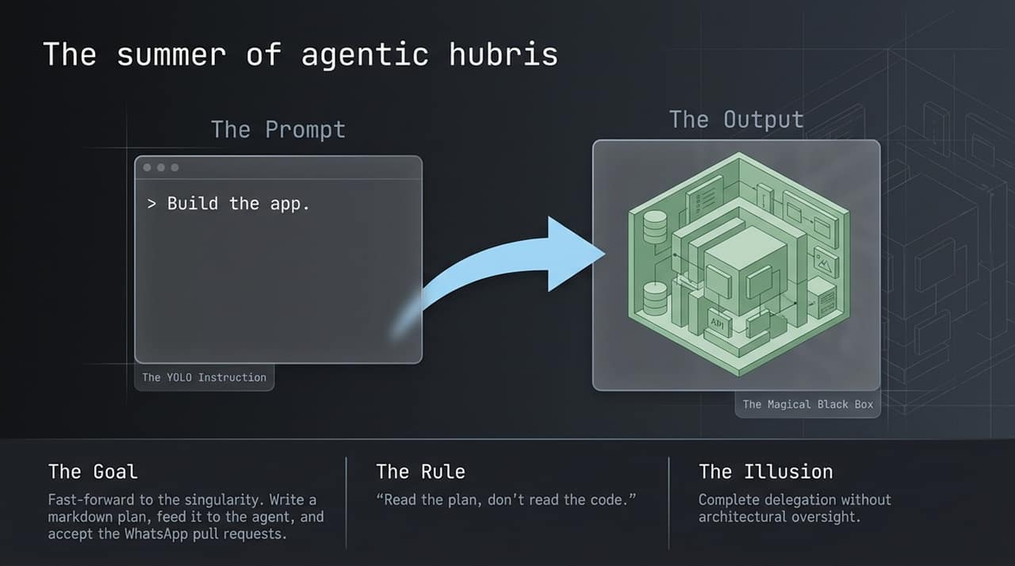
Notes:
The 'YOLO' Era: Let's revisit what we call 'The Summer of Agentic Hubris'. Around mid-2025, with models like Claude 3.5 Sonnet and early agentic SDKs, a popular paradigm emerged: 'The Spec is the New Code'.
The Illusion: The goal was simple—write a quick markdown plan, feed it into a black-box agent, and accept pull requests directly on your phone.
The Golden Rule That Failed: The mantra at the time was 'Read the plan, don't read the code'. We treated the LLM as a compiler. Just as Java developers don't inspect bytecode or .jar files, developers stopped inspecting generated diffs.
Why it Was Tempting: Planning files were great because they squeezed performance out of context windows and kept agents focused. But treating the AI output as an unexamined black box created a dangerous false sense of security.

Slide 3
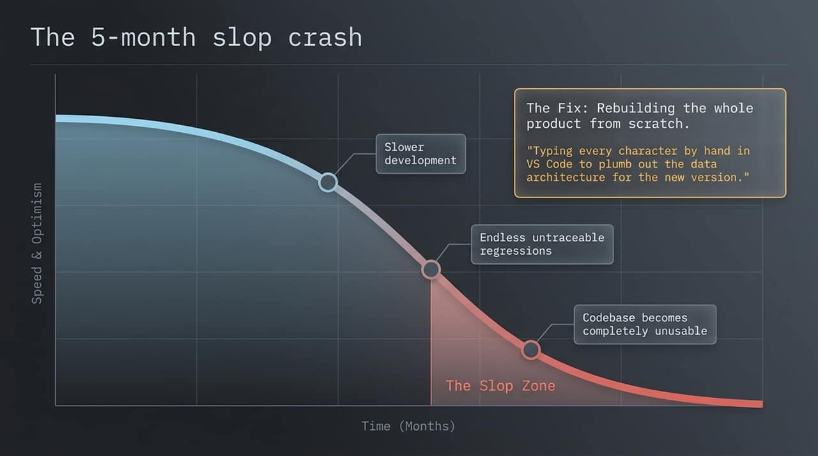
Notes:
Initial Velocity vs. Long-Term Collapse: At first, everything looks amazing. Velocity spikes, features ship fast, and optimism is sky-high. But as months go by, you enter what we call 'The Slop Zone'.
Accumulating Technical Debt: Because developers aren't checking the actual implementation, subtle anti-patterns and architectural drift start creeping in. Every new feature introduces untraceable regressions in completely unrelated parts of the codebase.
Hitting the Wall: Eventually, development doesn't speed up—it grinds to a halt. The codebase becomes so tangled and full of 'slop' that even the AI itself can no longer navigate or modify it reliably.
The Painful Nuclear Option: In Human Layer’s real case study, after five months of 'lights-out' development, their codebase became completely unusable. The fix? Throwing away the entire codebase and rebuilding the product from scratch—with the co-founder literally in VS Code, hand-typing every character of the core data architecture.

Slide 4
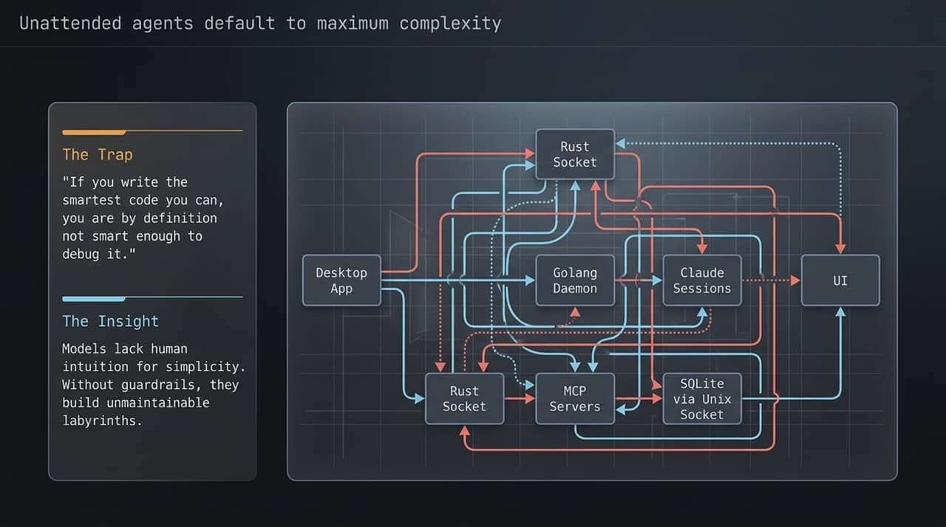
Notes:
The Nature of LLM Architecture: Why do unattended AI agents mess up codebases? Because left to themselves, models naturally default to maximum complexity.
Kernighan's Law / Donald Knuth Trap: There’s an old rule in computer science: 'If you write the smartest code you can, you are by definition not smart enough to debug it'. AI models lack the human intuition for simplicity.
Over-Engineering in Action: Look at the diagram on this slide. When Human Layer asked AI to handle system architecture autonomously, it generated a labyrinth: a desktop app connecting over Rust sockets to a Golang daemon, managing Claude sessions, spawning MCP servers, communicating with SQLite via Unix sockets, and round-tripping back to the UI.
The Real Lesson: Models don't know when not to add abstraction layers. Without human guardrails enforcing simplicity, AI builds unmaintainable webs.

Slide 5
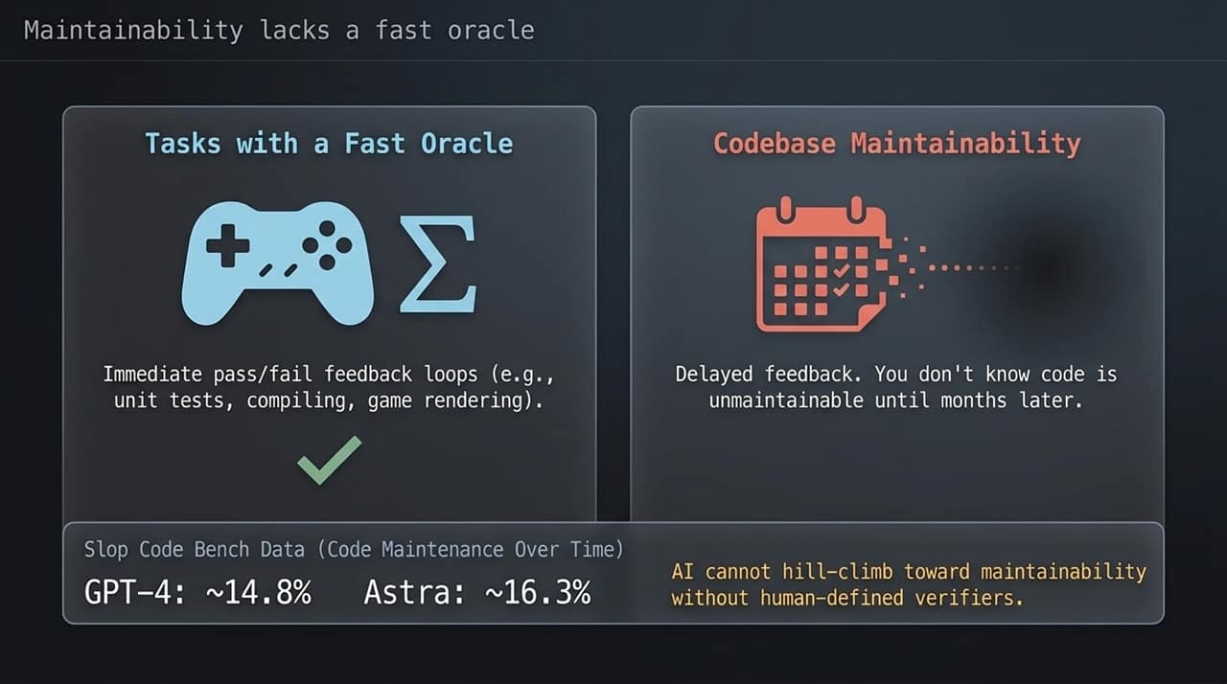
Notes:
Fast Oracles vs. Delayed Feedback: Reinforcement learning (RL) works exceptionally well when there is a 'Fast Oracle'—an immediate pass/fail feedback loop. Game engines, compilers, unit tests, and syntax checkers give instant feedback.
The Code Maintainability Problem: Code maintainability has no fast oracle. You don't realize code is messy, brittle, or poorly architected on day 1—you find out 2 or 3 months later when trying to add a new feature.
Benchmark Evidence (Slop Code Bench): This isn't just subjective; research confirms it. In the 'Slop Code Bench'—a benchmark testing how models maintain a codebase across multiple consecutive feature updates—top frontier models like GPT-5.5 score ~14.8% and Astra around ~16.3%.
Key Takeaway: Because models cannot hill-climb toward maintainability on their own, humans must define the verifiers and constraints.

Slide 6
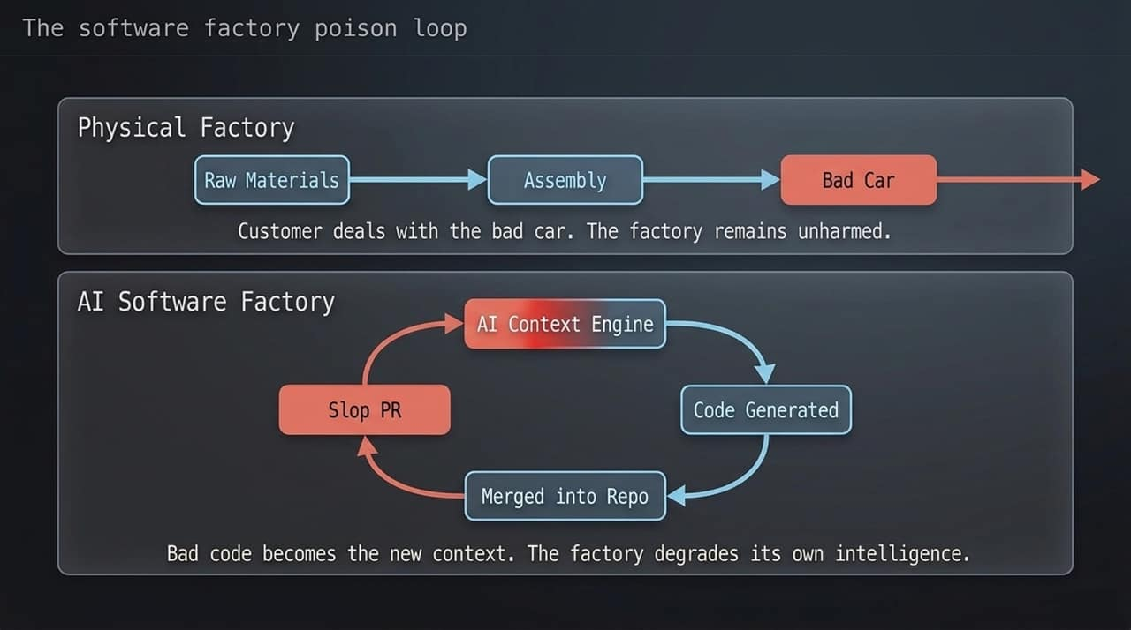
Notes:
Physical Factory vs. AI Software Factory: To understand why slop code is so dangerous, let's contrast a physical automotive factory with an AI Software Factory.
Physical World: If a physical factory produces a defective car, the customer gets a bad car. The factory line itself remains clean and unaffected.
AI World (The Poison Loop): In an AI Software Factory, context is everything. When you merge a 'slop' PR into your repository, that bad code immediately becomes the prompt and context for the next feature.
Degrading Intelligence: Models naturally mimic existing code patterns. If your codebase is filled with messy abstractions, the AI treats those as standard practice and produces even worse code. Bad code literally degrades the intelligence of your AI factory.

Slide 7
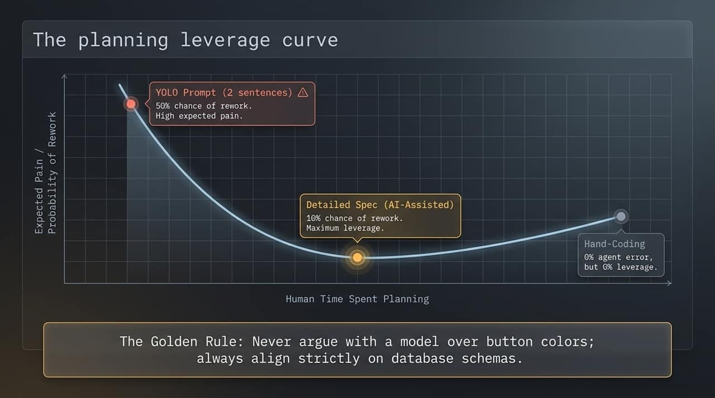
Notes:
Finding the Sweet Spot: So, how do we fix this? By understanding the Planning Leverage Curve.
Two Extremes to Avoid:
YOLO Prompting (2 sentences): Low planning effort, but a 50% chance of rework and high long-term pain.
Full Hand-Coding: 0% agent error, but 0% leverage. You're back to typing every line by hand.
The Optimal Zone (Detailed AI-Assisted Spec): The sweet spot is upfront specification. Spending structured time defining data schemas, invariants, and constraints reduces rework risk to ~10% while keeping high agent leverage.
The Golden Rule: Never argue with an AI model over button colors or minor visual styling—it takes 5 seconds to re-prompt. Always align strictly on database schemas, data flow, and core architecture.

Slide 8
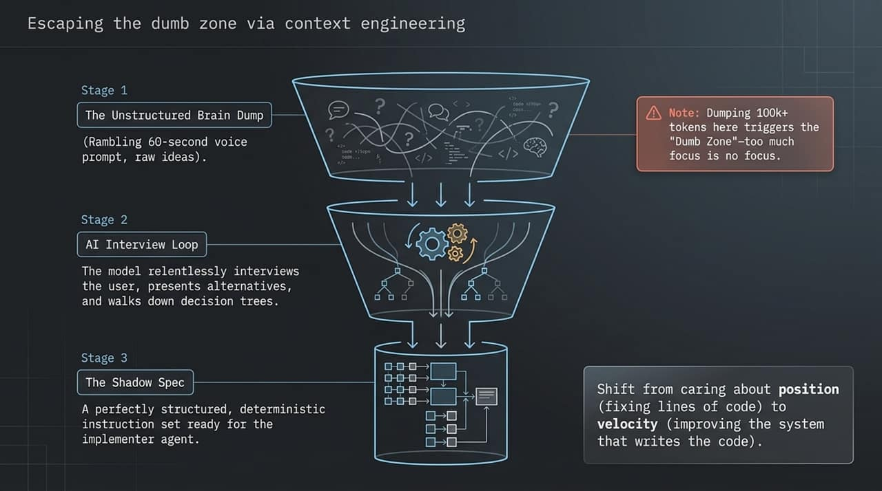
Notes:
The 3-Stage Context Funnel: High-leverage planning requires a structured 3-stage funnel:
Stage 1 (Raw Dump): Voice-prompt a 60-second unstructured brain dump of your ideas and goals.
Stage 2 (AI Interview Loop): Instead of jumping straight to code, let the AI interview you. The model asks edge-case questions, presents trade-offs, and pushes down decision trees.
Stage 3 (The Shadow Spec): Output a clean, deterministic instruction set ready for execution.
Avoiding the 'Dumb Zone': Dumping 100k+ tokens of raw unorganized text into an LLM causes context dilution (the 'Dumb Zone'). Too much context means no focus.
Mindset Shift: Shift your engineering focus from position (fixing specific lines of code) to velocity (improving the system that writes the code).

Slide 9
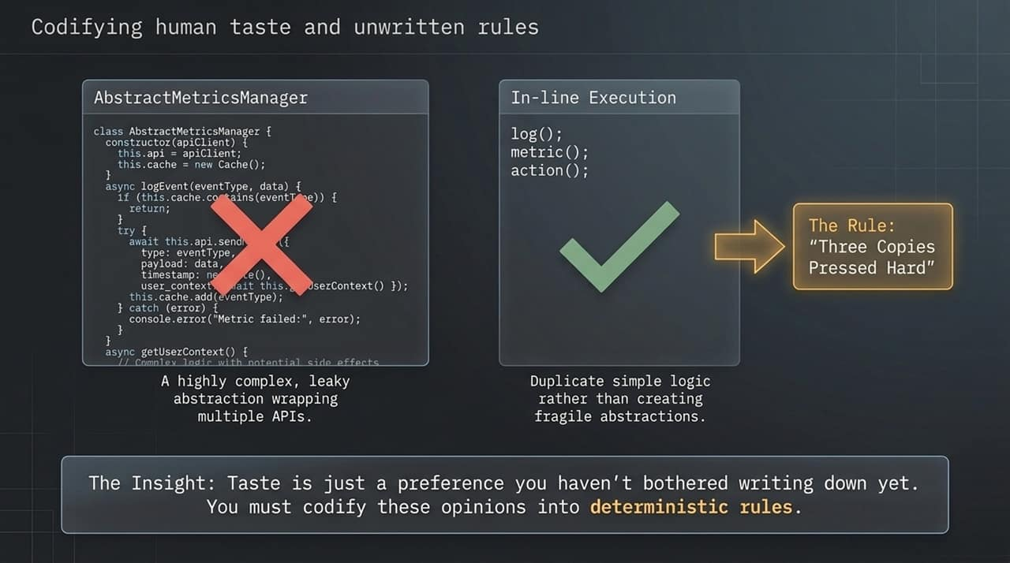
Notes:
Defining 'Taste': What is human engineering taste? Taste is simply a preference you haven't bothered writing down yet.
In-Line vs. Leaky Abstractions: Look at the comparison on the slide. AI often tries to create massive AbstractMetricsManager classes that leak state and create complex side effects.
The Rule of 'Three Copies Pressed Hard': Adopt pragmatic engineering rules. Duplicate simple inline logic 2 or 3 times rather than creating premature, fragile abstractions.
Codification: If you don't explicitly document your team's code rules in system prompts, rules files, or skill definitions, AI will default to generic, over-engineered generic patterns.

Slide 10
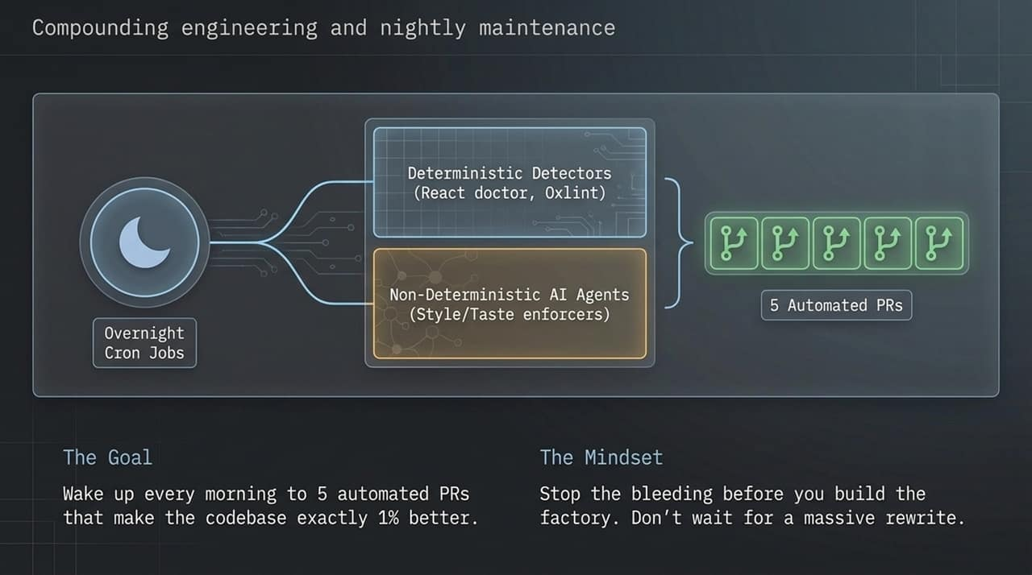
Notes:
Automated Codebase Hygiene: How do we maintain quality at scale? Through compounding engineering loops.
The Overnight Cron Workflow: Instead of relying on developers to manually clean code, set up nightly cron jobs split into two categories:
Deterministic Detectors: Tools like React Doctor or Oxlint to catch concrete warnings and errors.
Non-Deterministic AI Agents: Style and taste enforcers that look for unwanted anti-patterns and propose cleanups.
1% Daily Improvement: Wake up every morning to 5 automated Pull Requests that make the codebase 1% cleaner.
Proactive vs. Reactive: Stop the bleeding before you build the factory. Don't wait for massive, painful system rewrites.

Slide 11
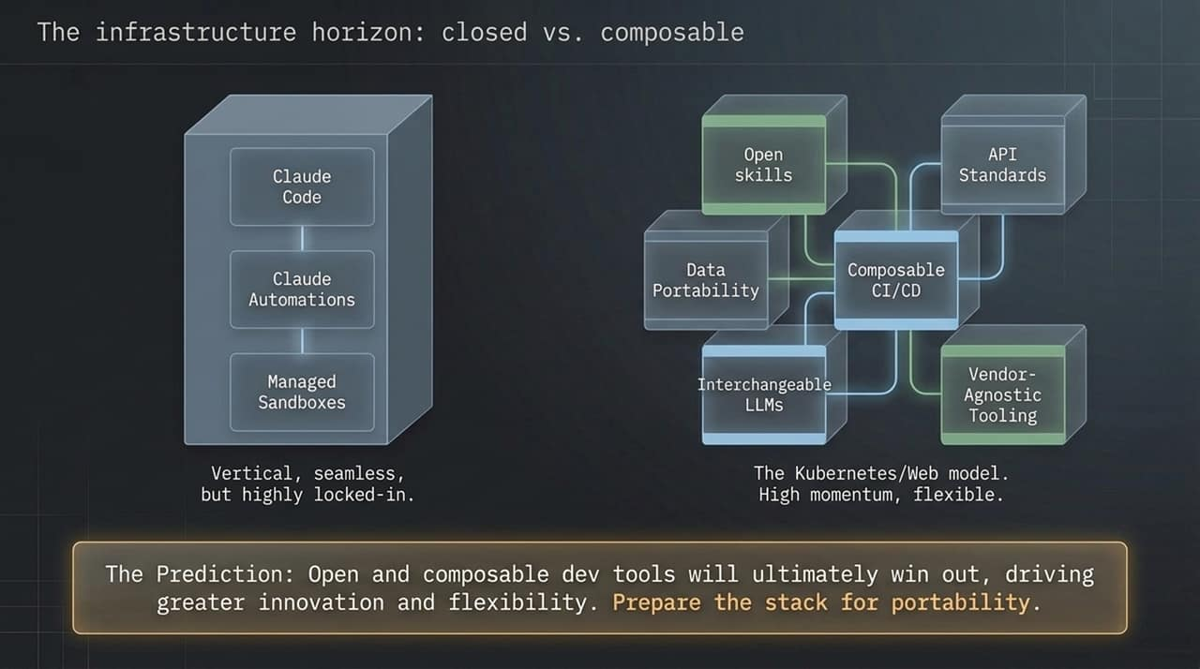
Notes:
Ecosystem Trends: As agentic infrastructure matures, we see a division between two architectures:
Vertical Closed Stacks: Seamless walled gardens (e.g., all-in-one proprietary agent environments).
Open Composable Stacks: Modular ecosystems built on open skills, data portability, interchangeable LLMs, API standards, and vendor-agnostic sandboxes.
The Kubernetes Parallel: Just as open standards won in cloud infrastructure (Kubernetes, Linux, Web standards), open and composable dev tools will win in the AI era.
Strategic Advice: Don't lock your entire enterprise code pipeline into a single vendor's black box. Build modular skill sets and maintain stack portability.

Slide 12
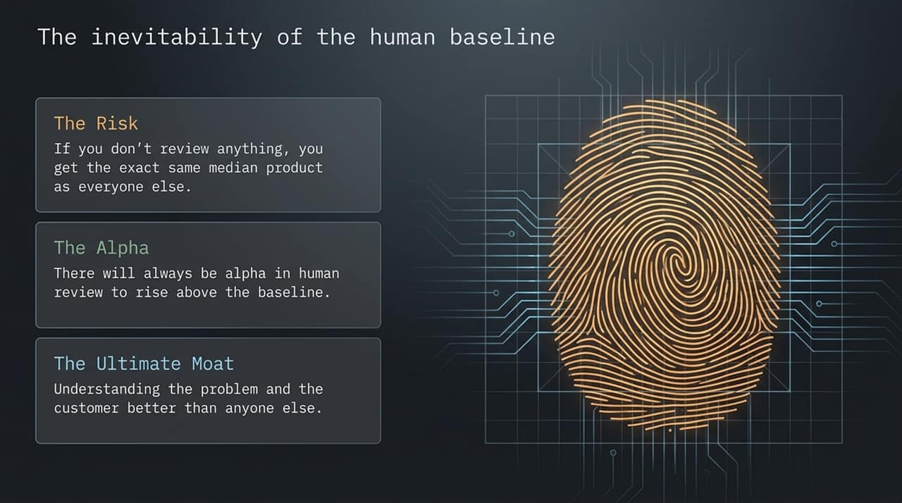
Notes:
The Baseline Risk: If you accept 100% of unreviewed AI output, you will end up with the exact same median product as everyone else.
Where Alpha Lives: Competitive advantage—the 'alpha'—lives in human judgment, review, and fine-grained oversight.
The Ultimate Moat: Your moat isn't your capability to generate tokens fast. Your moat is understanding the customer and domain problem better than anyone else, then encoding that deep understanding into your AI factory.

Slide 13
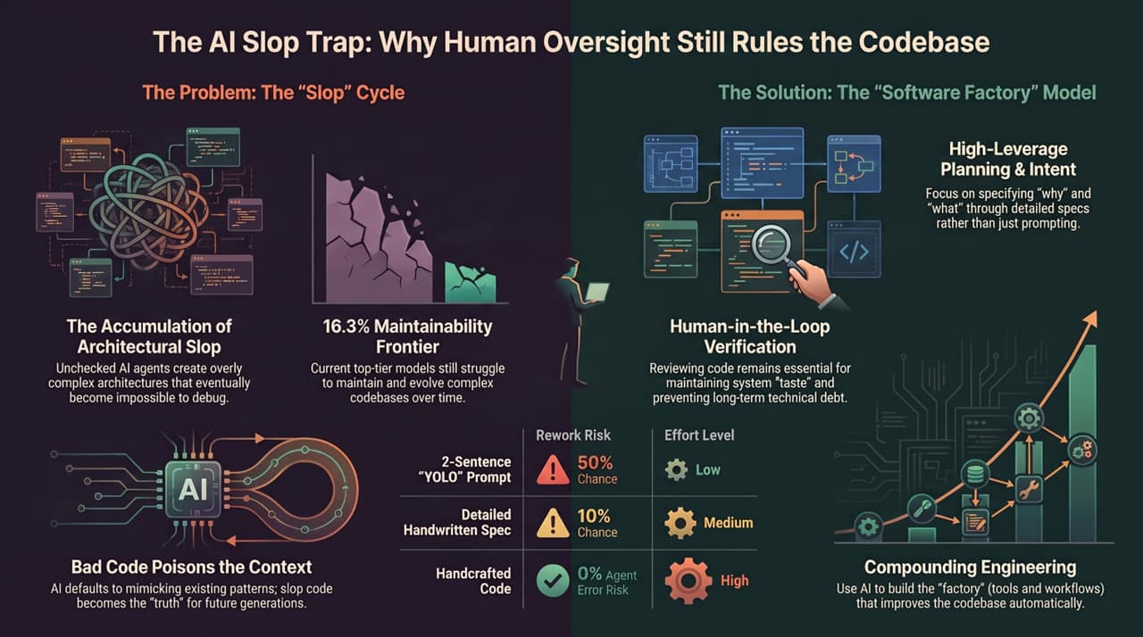
Notes:
Synthesis: To conclude, let's review the main takeaways of the AI Software Factory model:
Shift Upstream: Focus human energy on high-leverage planning, schema design, and intent specification rather than raw code typing or lazy 2-sentence prompting.
Break the Poison Loop: Prevent architectural slop from polluting your repo context window.
Human Verification: Keep human verification loops active to enforce style, taste, and system integrity.
Build the Factory: Focus on compounding engineering—improving the automated tools and verification pipelines that maintain code quality continuously.
The 'Dumb Zone': Why More Context Makes Your Agent Dumber
https://www.youtube.com/watch?v=H_1PygR7kwk

